Slide 1
Robust Deep learning Based Satellite Tracking Methodology
COOPERANTS
By Souptik Sen

Slide 2
Contents:
Problem Statement
Dataset
Data Pre-Processing
Proposed DL Architecture
Data Processing
TCN and Multi-Head Cross Attention Architecture
Autoregressive Decoder
Masking of Decoder sequence
Loss
Metrics
Results and Parameter Optimization
Results Visualized

Slide 3
Problem Statement
Because of the hazards and challenges of the space environment, Satellites are usually exposed to orbit deviation, collisions with debris, or loss of tracking control. Therefore, orbit prediction can be defined as the critical and significant role for satellite monitoring and tracking control to reduce the risk of space debris and satellite malfunction.
This solution proposes a novel orbit prediction approach based on Two Line Element (TLE) Satellite data using A Temporal Convolutional Network based Encoder Decoder Architecture.

Slide 4
Dataset Used
Two Line Elements (TLE) data that is collected by NASA (National Aeronautics and Space Administration) & NORAD (North American Aerospace Defense Command) using Radar is used to send out a single a set of orbital components that has been coded that properly describes the orbit of the satellite around the Earth .
The model was trained on the historical position and velocity vector data of 25 different satellite launched on different dates varying from 1960 to 2023, like Vanguard 3 ,Explorer 7, IRIDIUM 7 and other satellites. The model was tested to predict the position and velocity vectors of 10 different satellites with varying launch dates.
The TLE data, which is the standard data format for Satellite navigation, consists of all the information of the satellite like Satellite Identification Number, launch date etc along with Kepler’s 6 parameters for an astronomical object.

Slide 5
Data Pre-Processing
The dataset consists of Kepler’s six parameters for an astronomical object, namely Inclination (Degrees) , Right Ascension of Ascending Node (Degrees),Eccentricity, Perigee Argument (Degrees), Mean Anomaly (Degrees) and Mean Motion (Revs per day) for each epoch. The position and velocity vectors at each epoch for a satellite are calculated using Lagrange’s equations on these six parameters.
After calculating the position and velocity vectors at each epoch, missing values are determined and filled accordingly by using temporal interpolation to construct an uniformly distributed dataset on a temporal scale. After filling out the missing values, a thorough Fast Fourier Transformation (FFT) is conducted for all the dimensions of the position and velocity vectors to determine the most dominant temporal frequency.
This dominant frequency is used to reconstruct the position and velocity vectors in the form of sine and cosine waves by using reverse FFT, thus switching back from the frequency scale to the temporal scale. These waves are added to our original dataset of position and velocity vectors to prepare our final dataset.

Slide 6
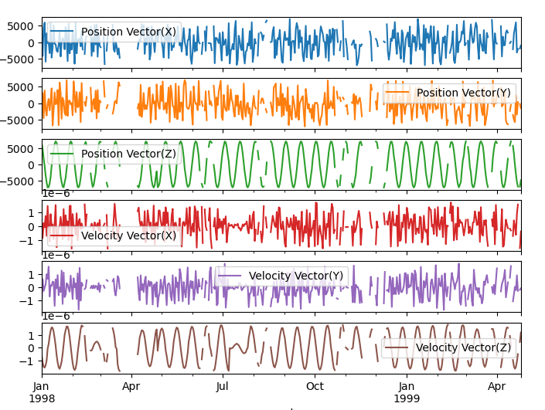
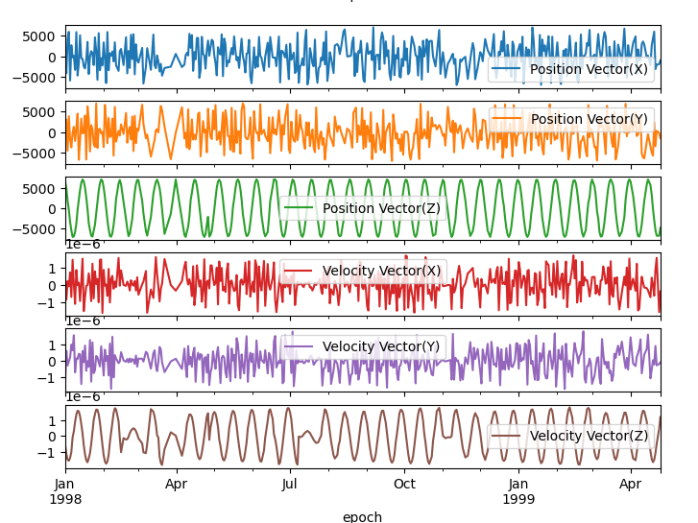
Missing values handling by temporal interpolation

Slide 7
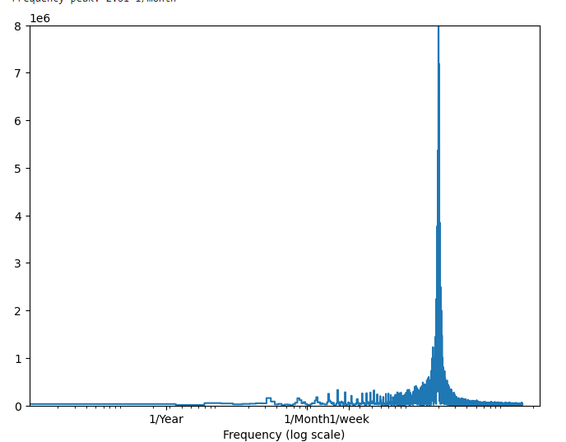
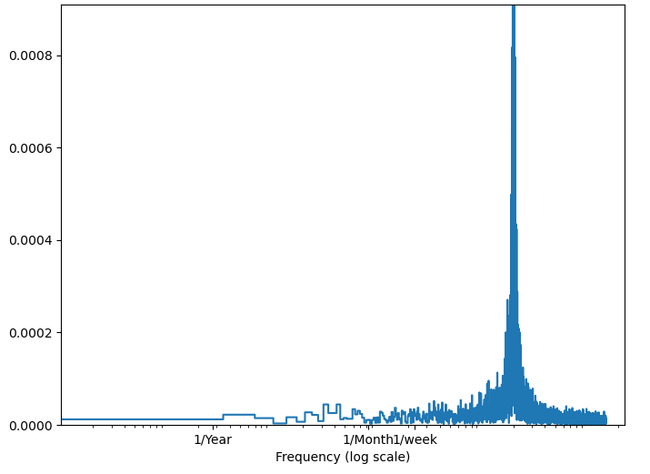
FFT Frequency Domain Visualization
Position vector X
Velocity vector X

Slide 8
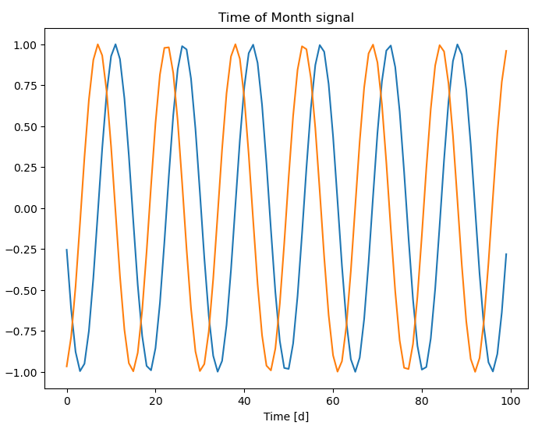
Reverse FFT sine-cosine wave transformation
Position vector X

Slide 9
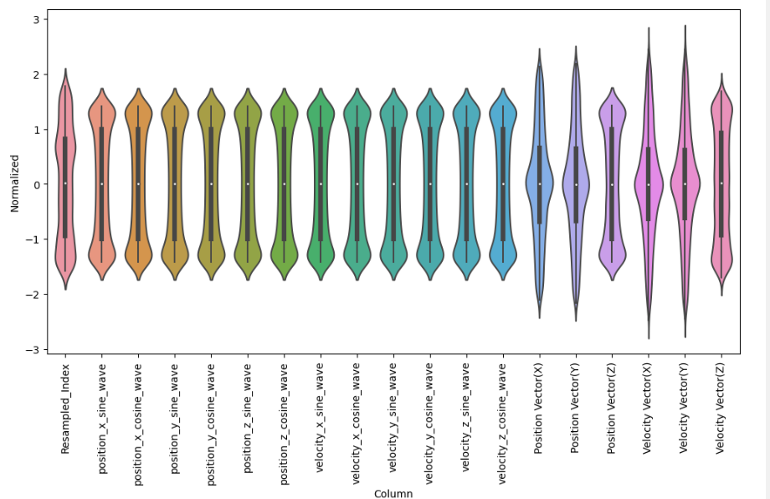
Normalization

Slide 10
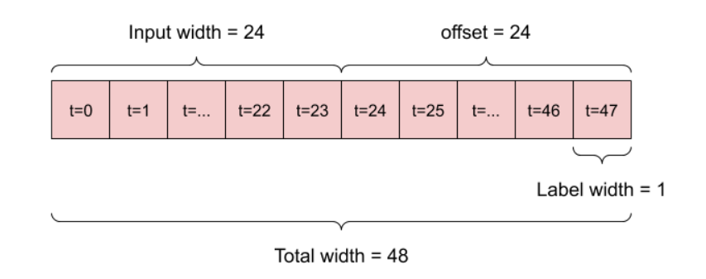
Data processing
The dataset is split into training, testing and validation datasets. The separate datasets are scaled and normalized separately to avoid any kind of overfitting or data anomalies.
The datasets are then windowed temporally by using a sliding window operator function to generate input and target sequences for our model.
The generated sequences are then segregated into Encoder sequence and Decoder sequence.
Encoder sequences~ consists of both the input and target feature values of the input sequences.
Decoder sequences~ consists of the target features values of the target sequences.

Slide 11
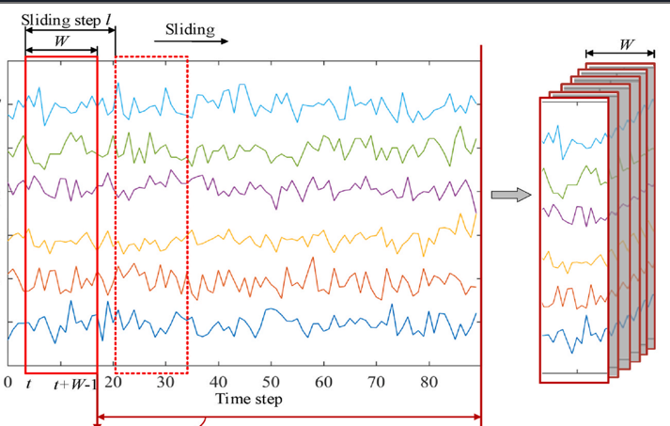
Temporal Windowing

Slide 12
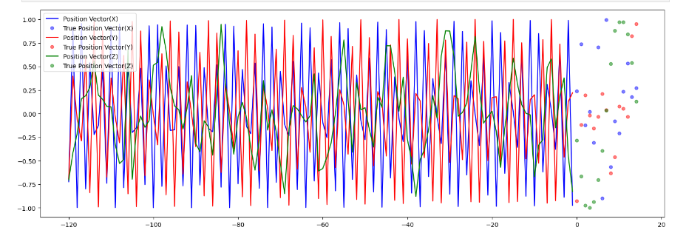
Temporal Windowing Visualized ( i/p w = 120, o/p w = 20)

Slide 13
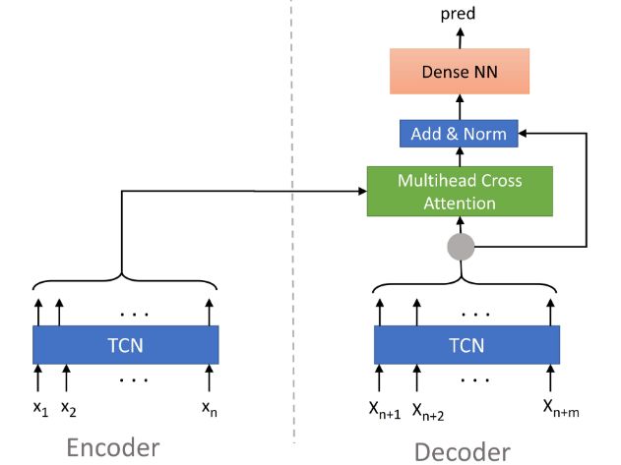
Proposed Architecture
The proposed architecture is a TCN-TCN attention based encoder decoder architecture.

Slide 14
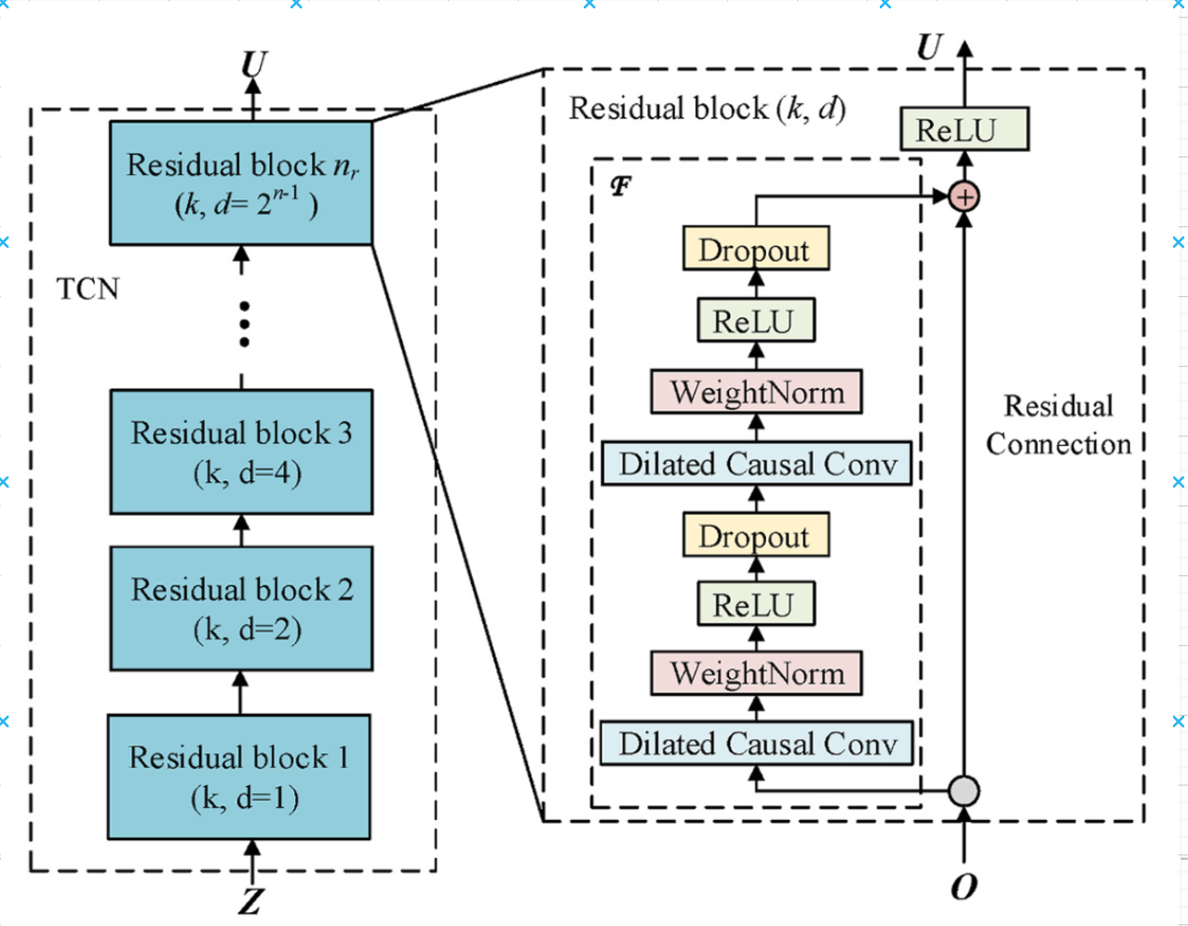
Temporal Convoluted network
One TCN cell (residual block) is structured like this (when choosing ReLu as activation function).
The Residual connection helps in rapid backpropagation process and helps in parallelization. The TCN does not have to depend on the output of the previous timestep for loss propagation unlike LSTMs.

Slide 15
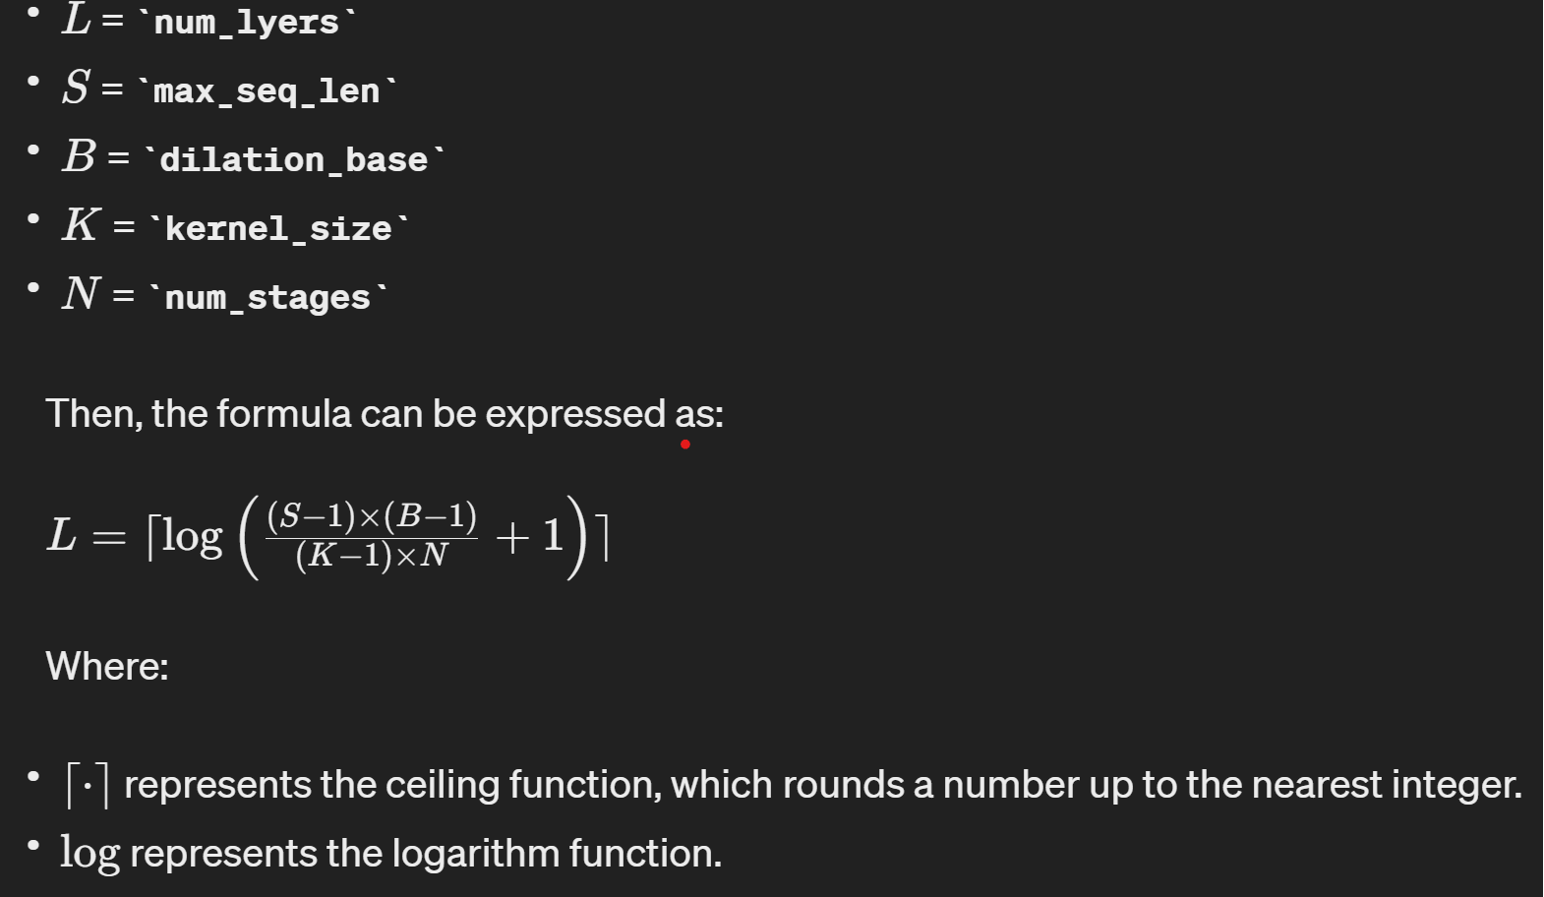
Choosing Number of Residual Blocks L
The TCN blocks use as many layers as needed to get a connection from first time step input to last timestep output i.e the number of layers are determined by the number of timesteps in our training dataset in the following way.

Slide 16
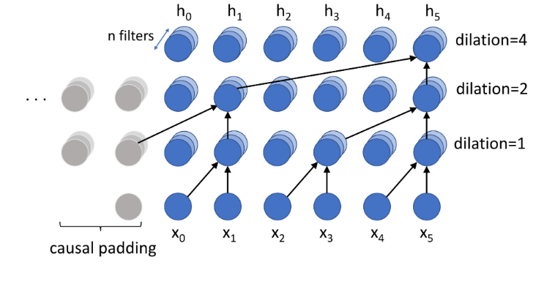
Up Close Dilated Convolutions with Causal Padding
Causal Padding : Output at time t is convolved only with elements from time t and earlier (0 to t-1) in the previous layer. In order to achieve this, zero padding of length (kernel size − 1) is added to keep subsequent layers the same length as previous ones.
Dilated Causal Convolutions: Dilation is equivalent to introducing a fixed step between every two adjacent filter taps. When d = 1, a dilated convolution reduces to a regular convolution. Dilation exponentially increases the receptive field of a TCN.

Slide 17
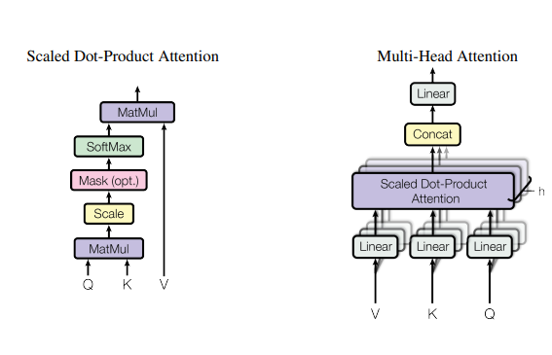


Multi-Head cross Attention
K - Key
V - Value
Q - Query

Slide 18
AutoRegressive Decoder
Autoregressive Decoder:
For training, teacher-forcing is used for the decoder. In addition to other decoder input data that is defined by the user, always the ground truth of the previous time step is added as an additional feature. For example at position x(n+1) the ground truth at position x(n) is added as an additional input. During inference, the predictions of the previous time step is used instead. The autoregressive model can be trained fast in a parallel way.

Slide 19
Masking of Decoder Sequence ( Noisy teacher Forcing)
As mentioned earlier, the training of this model is done by using teacher-forcing i.e in an autoregressive manner. But when dealing with low amounts of data like real-world satellite navigation data , this can easily lead to overfitting to the decoder input sequences without using the multi-head cross attention layer.
To counter this problem , the decoder input sequences are deliberately perturbed by randomly changing one randomly selected feature vector at each epoch of the decoder input sequences with a random value. This makes the model more dependent on the encoder output and counters overfitting, making the model extremely robust to new types of data( for eg. different satellite data) and high learning rates.

Slide 20
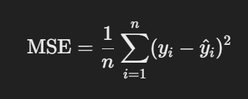
Loss :
Mean Squared Error (MSE) Loss:
Definition: Measures the average squared difference between the actual and predicted values.
Where yi is the actual value, y^hat​i​ is the predicted value, and n is the number of observations.

Slide 21
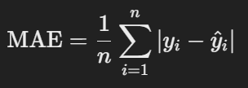
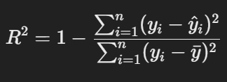
Metrics:
Mean Absolute Error (MAE) Loss:
Definition: Measures the average absolute difference between the actual and predicted values.
R² (Coefficient of Determination):
Definition: Indicates the proportion of the variance in the dependent variable that is predictable from the independent variables.

Slide 22
Parameter Optimization
Wrapper classes are included in this model to automate hyper-parameter tuning. Bayesian Tuner has been used to find the best possible hyper-parameters based on the validation loss of the dataset over a specified number of trials. The different hyper-parameters include key/value size of multi-head attention layer, kernel size of TCN layer etc.

Slide 23
Results
The model was trained on the historical position and velocity vector data of 25 different satellite launched on different dates varying from 1960 to 2023.
This model has achieved a best MSE loss of 0.0136 and MAE loss of 0.0670 on test datasets of BREEZE, IRIDIUM7, IRIDIUM914, STARLINK1098 and other testing data satellites.
The model has achieved a R-squared value or goodness of fit of 96% across our training datasets, making this model very robust for a general purpose satellite tracking model.

Slide 24
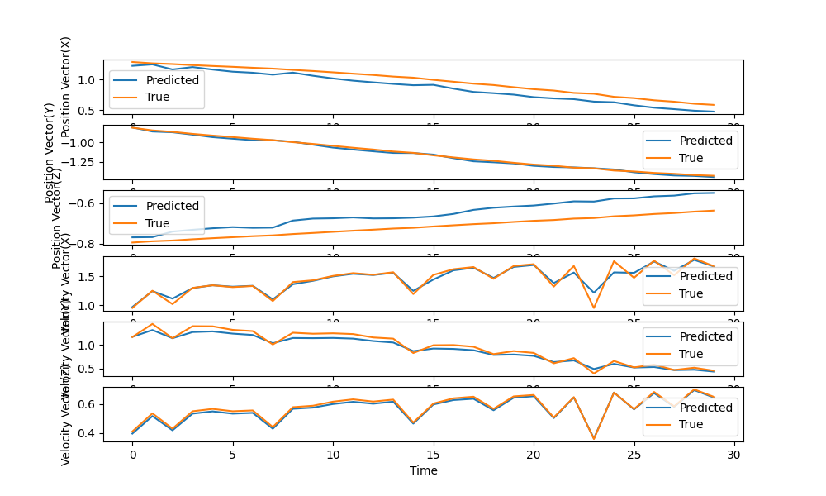
Results Visualized
BREEZE

Slide 25
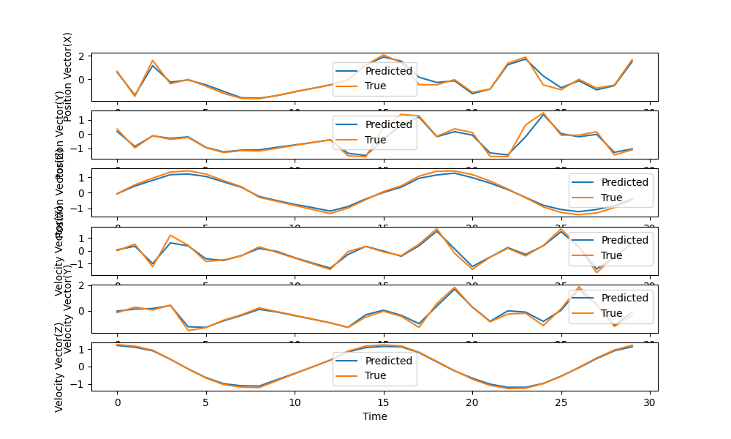
Results ( IRIDIUM 914 )

Slide 26
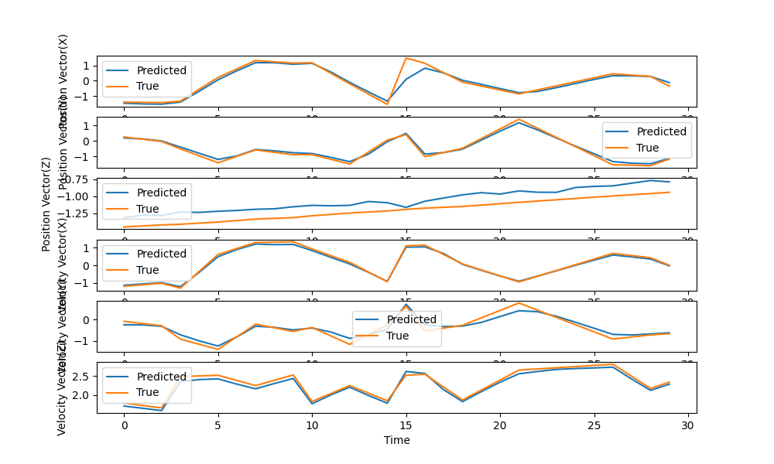
Results (LEASAT)

Slide 27
Thank you for your Attention!

